Slide 1
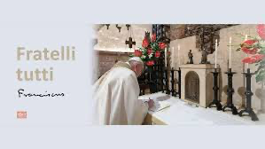
Franciscans Living in Community
Reflecting and Praying with Fratelli Tutti

Slide 2
Challenge
Notice the word challenge and you are fully aware of the fragmentation and divisions that exist in our world today. We are far, very far from the world of unity, fraternity and friendship that Jesus wishes for us, that the Church encourages us to create and that the Gospels remind us we are to be citizens of the Kingdom of God that is being created in the here and now.

Slide 3
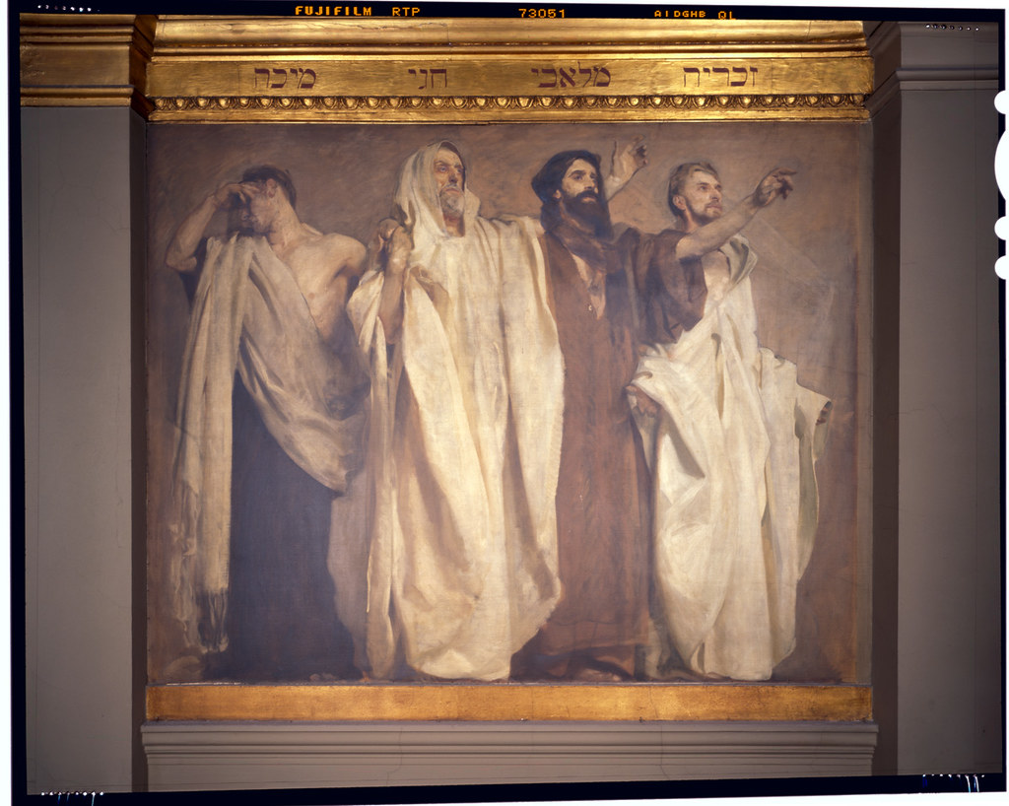
Can’t Abide Prophets

Slide 4
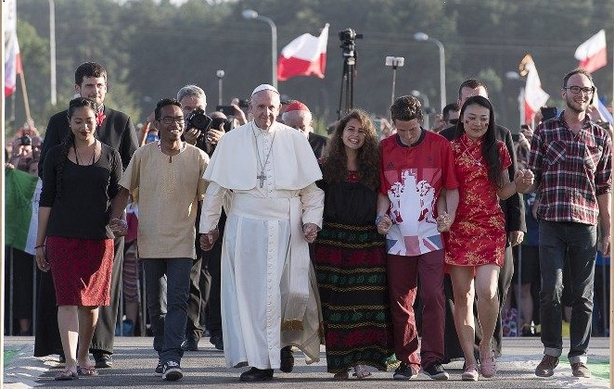
A Prophetic Message
Pope Francis and his Encyclical Fratelli Tutti is a prophetic message for the People of God and indeed for all peoples, so you and I can see and hear what our blindness and deafness cheerfully ignores. Prophets stand perpetually in God’s presence, overwhelmed by heaven’s perspective. The seer’s and by extension Pope Francis’ job is to shatter indifference and spell out options. As the prophet is broken open by God’s pain, so must he or she become the heart-breaker of the whole community.

Slide 5
This Photo by Unknown Author is licensed under CC BY

Slide 6
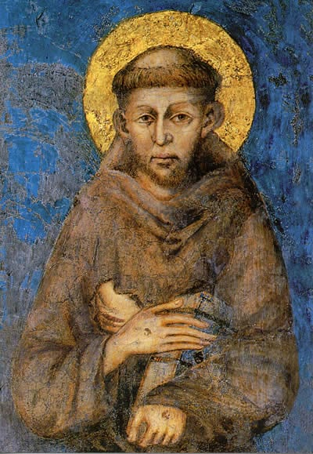
Franciscans, because we by our profession are called to a communal life, fraternal sharing and a friendship that is physical, emotional and spiritual are poised during this year of 2022 to spark a revolution of the heart, that will eradicate indifference, console the heart of God and restore the law as love as the foundation of human dialogue that will lead to the dignity of every human being and restore the culture to Christ who is the Way, the Truth and the Life. Your pathway to accomplish this is the Gospel, your Rule and your witness to your fraternity and fraternal life.

Slide 7
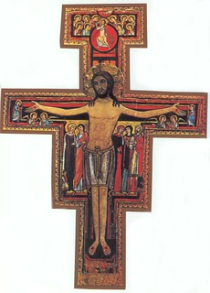
Fratelli Tutti, becomes that prophetic voice that
we need today to encourage us in our struggle
to overcome the indifference of our world,
to reject the culture that excludes Christ from
the human conversation and to become courageous
enough to begin again to rebuild and restore
the Kingdom of God, now! Nearly 9 centuries ago,
our Father Francis heard Christ from the Cross,
Francis, Francis rebuild my Church.
Today it is the voice of Pope Francis
that cries out to you and I rebuild our world,
restore the human family to the dignity
that God has given each of us for
we are made in the image and the
likeness of God.

Slide 9
A Trilogy of Hope

Slide 10
A Gospel of Life
Every individual, precisely by reason of the mystery of the Word of God who was made flesh (cf. Jn 1:14), is entrusted to the maternal care of the Church. Therefore every threat to human dignity and life must necessarily be felt in the Church's very heart; it cannot but affect her at the core of her faith in the Redemptive Incarnation of the Son of God, and engage her in her mission of proclaiming the Gospel of life in all the world and to every creature (cf. Mk 16:15). Today this proclamation is especially pressing because of the extraordinary increase and gravity of threats to the life of individuals and peoples, especially where life is weak and defenseless. In addition to the ancient scourges of poverty, hunger, endemic diseases, violence and war, new threats are emerging on an alarmingly vast scale.

Slide 11
The Joy of the Gospel
The joy of the gospel fills the hearts and lives of all who encounter Jesus. Those who accept his offer of salvation are set free from sin, sorrow, inner emptiness and loneliness. With Christ joy is constantly born anew. In this Exhortation I wish to encourage the Christian faithful to embark upon a new chapter of evangelization marked by this joy, while pointing out new paths for the Church’s journey in years to come.

Slide 12
FRATELLI TUTTI” With these words, Saint Francis of Assisi addressed his brothers and sisters and proposed to them a way of life marked by the flavour of the Gospel. Of the counsels Francis offered, I would like to select the one in which he calls for a love that transcends the barriers of geography and distance, and declares blessed all those who love their brother “as much when he is far away from him as when he is with him. In his simple and direct way, Saint Francis expressed the essence of a fraternal openness that allows us to acknowledge, appreciate and love each person, regardless of physical proximity, regardless of where he or she was born or lives.

Slide 13
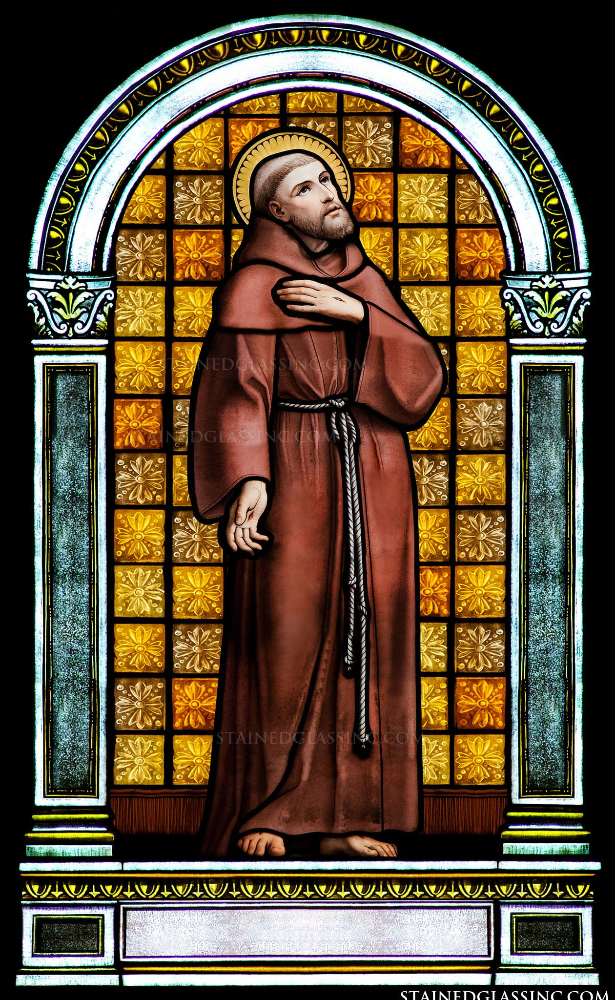
A 21st Century Letter to the Faithful
What I point out to you in particular is the line that literally says it all….a way of life marked by the flavour of the Gospel. This document is comparable to the letter to the faithful that Francis issued in his lifetime and in the 21st century his namesake issues a like appeal to the Catholic and non-Catholic world. A necessary appeal, a prophetic message to a world spinning out of control having lost its moral compass, its spiritual moorings, and the energy to stop a free fall into chaos and disorder where culture is being truncated and civilization is being held hostage to forces that promote evil and the outcome is a continuation of a culture of death.

Slide 14
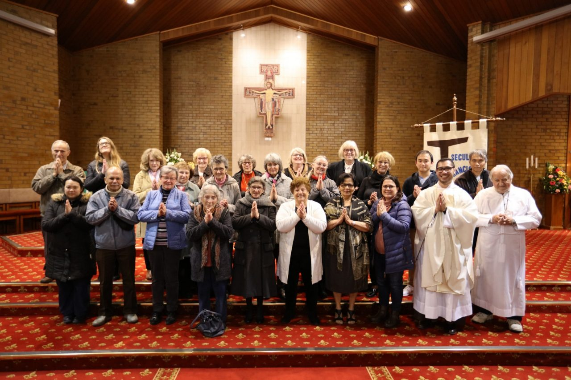
Fraternity
Fraternity is a charism/gift of the Franciscan movement. The Spirit creates a desire and capacity for community - “fraternity” not only on the human level but in relationship to all that is. Because all creatures come from the same Creator, the creatures are in relationship to all other creatures
(Wm Hugo OFMCap)

Slide 15
Why Fraternity Fraternity Allows
It is a gift from God
It is a calling in which we recognize the power of the Spirit gathering us
It is an expression of our poverty
Because Jesus became a brother to all of us in the Incarnation
The love of God is manifest in all creation
God gives us the power to love one another
Sense that we are gathered in the Lord’s name called to live out the Gospel with those called to share life with us.
Hearts freed from self interest
Ability to forgive
Ability to ask pardon
Shared responsibility for our life together
Mutuality toward the sick as as healthy members
Not to become angry or disturbed because of the faults of another
Making needs known
Admonish with great mercy
It requires the love of each person
Willingly serve and obey one another with charity (Margaret Carney/Thaddeus Horgan)

Slide 16
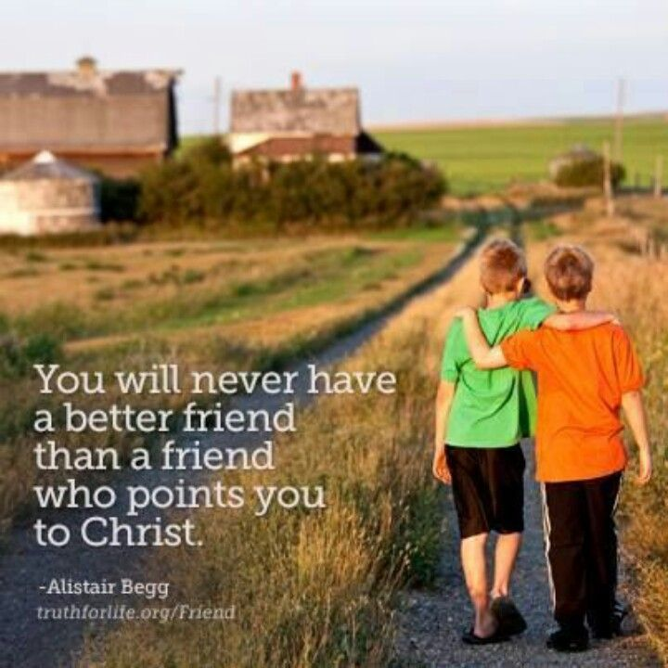
Christian Friendship
Shared hope in the Gospel A Heart of Service
Realistic Expectations Gentle Admonition
Framework for forgiveness Shared Eternal Life
Family Commitment
Trustworthy discretion
True Generosity
Encouragement to stand strong
Selfless love
The Rule of Peace

Slide 17
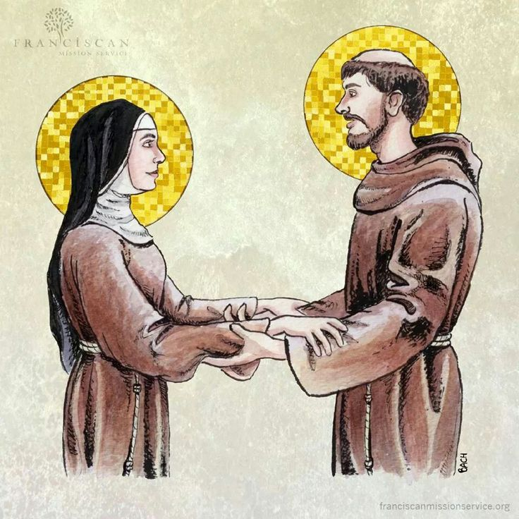
Christian Friendships

Slide 18
An example of Fraternity and Friendship

Slide 19
St Francis and the Sultan Lesson for us!
It is Francis of Assisi who begins the process that Pope Francis continues today and that is to foster a culture of encounter that is a countermeasure to the culture of indifference that we now are subjected to and which has dire consequences for all of us.
One of the elements that I do believe you and I would find helpful in trying to decipher all of the nuances, the theology, scripture, the political and social images and language presented in this unique document is to use a template that you and I are so familiar with and that is the Rosary and in particular that of the Joyful Mysteries.

Slide 20
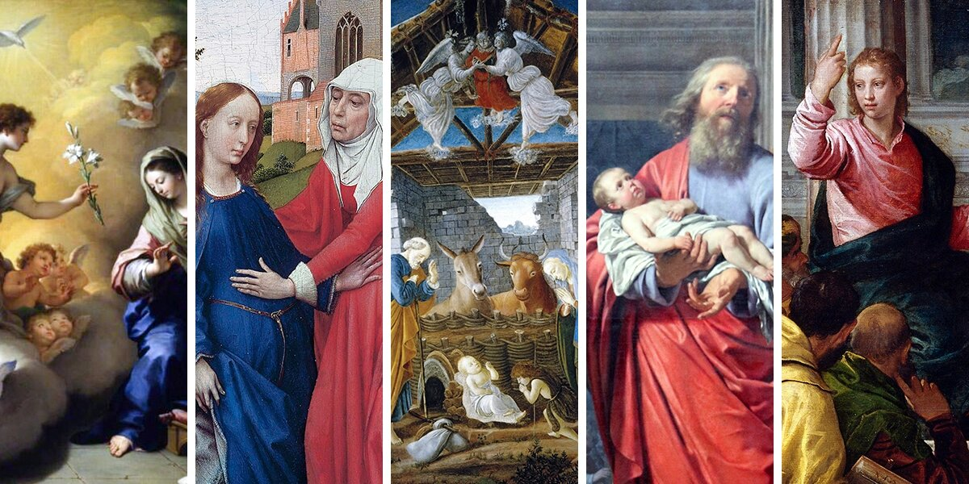

Slide 21
…You will ask me now: what is meant by cordial friendship? It means that it has its foundation in the heart. As you have asked me, I will explain that cordial love with which the Sisters should love one another. This sort of love is nothing less than that of true and sincere friendship, which can only occur between reasonable people…This friendship must be grounded in the heart..we are told by God to love our neighbor…but we must love one another with the same expansiveness of our hearts, not simply as we love ourselves, as God commands us, but more than ourselves to observe the rules of Evangelical perfect which asks this of us. Our Lord has said: “Love one another as I have loved you.”
…This cordial love must be accompanied by two virtues: civility and gracious communication. Civility lends a certain agreeable tone to all the serious transactions and dealings we have with one another. Gracious conversation allows us to enjoy less-serious Recreation and encounters with our neighbors. All virtues, as you know, have contrary vices. Which are the extremes of virtue. civility is not found between too much unrelenting seriousness and too much sentimentality and false flattery. The virtue of gracious conversation requires that you share a holy and moderate Joy, not boring your neighbor with your Melancholy complaints or refusing to join in at the time set aside for recreation and entertainment. you must continue to hold on to the affection you have for one another as equitably as possible. All must know that they are loved with this cordial heartfelt love equally.

Slide 22
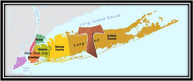
Matters of the heart, friendship, civility, conversation are as old as is the faith that you and I are heirs to. These same matters of heart, friendship, civility and conversation are also essential ingredients to the Franciscan Movement that allowed Fraternity and Peacemaking to be a part of the spiritual heritage that we now call upon to reinvigorate a social climate that has become twisted, malevolent and dangerous for all peoples, nations, and faiths.

Slide 23
“xenophilia” (love of strangers)
or
“xenophobia” (fear of strangers)

Slide 24
Dear Franciscan brothers and sisters the choice is clear because our fraternity lived with through the flavour of the Gospel, let us be witnesses to a new rebuilding of the Church and world in the 21st century. Let us combine the words Pax et Bonum with our fraternal hospitality and restore a world to a Xenophilia, a love of strangers, fulfilling the command to love one another as I have loved you.
In our afternoon session we will focus on the Parable of the Good Samaritan and the lessons that Pope Francis offers us in his reflection and some of the comments that we can share, discuss and reflect on as we delve into this most important and necessary document for Franciscans to use to restore the culture to Christ and aid in rebuilding a Civilization of love.

